Slide 1
Using MaxSAT to Correct Errors in AES Key Schedule Images
Xiaojuan Liao, Miyuki Koshimura, Hiroshi Fujita, Ryuzo Hasegawa
Hasegawa-Fujita Laboratory
Kyushu University

Slide 2
Outline
Cold Boot Attack
Advanced Encryption Standard (AES)
Recover AES key Schedule
  Using SAT solvers
  Using MaxSAT solvers
  Comparison
Experiment
Conclusion

Slide 3
Cold Boot Attack (1/2)
DRAM:
  Dynamic Random Access Memory
DRAM cell:
  a capacitor that is either 0 or 1
  0: ground state
  1: charged state
DRAM remanence:
  DRAM retains its contents for a period (seconds) after power is lost
  As time goes on, data may decay and eventually disappear
Cold boot attack:
  Exploit DRAM remanence to access sensitive data (e.g., encryption keys)

Slide 4

A Scenario of Cold Boot Attack
Use secret key to complete an online transaction
Case 1
Get the correct secret key!
leave
attacker comes
Case 2
secret key in memory
Remove the memory and retrieve the contents
Get the decayed key. How to recover?
Public computer room

Slide 5
Cold Boot Attack (2/2)
Decay patterns ¹
  Decay aggravates as time goes on
  Most bits decay to ground states (1→0)
  Only a small fraction (0.1%) flips to charged states (0→1)
This work
  Recover AES keys from decayed bits
¹ J. Alex Halderman et al., Lest We Remember: Cold Boot Attacks on Encryption Keys. USENIX08.

Slide 6
Outline
Cold Boot Attack
Advanced Encryption Standard (AES)
Recover AES key Schedule
  Using SAT solvers
  Using MaxSAT solvers
  Comparison
Experiment
Conclusion

Slide 7
Advanced Encryption Standard(AES)
What is AES
  A specification for the encryption of electronic data established by the U.S. NIST ¹
  Adopted by the U.S. government and used worldwide
AES key ²
  Initial key length: 128 bits (options:192 bits, 256 bits)
  AES-128 key schedule:
128-bit initial key
128-bit round key
128-bit round key
128-bit round key
…
0th round key
10 rounds
¹ NIST: National Institute of Standards and Technology
² Federal Information Processing, Announcing the ADVANCED ENCRYPTION STANDARD (AES), 2001.

Slide 8
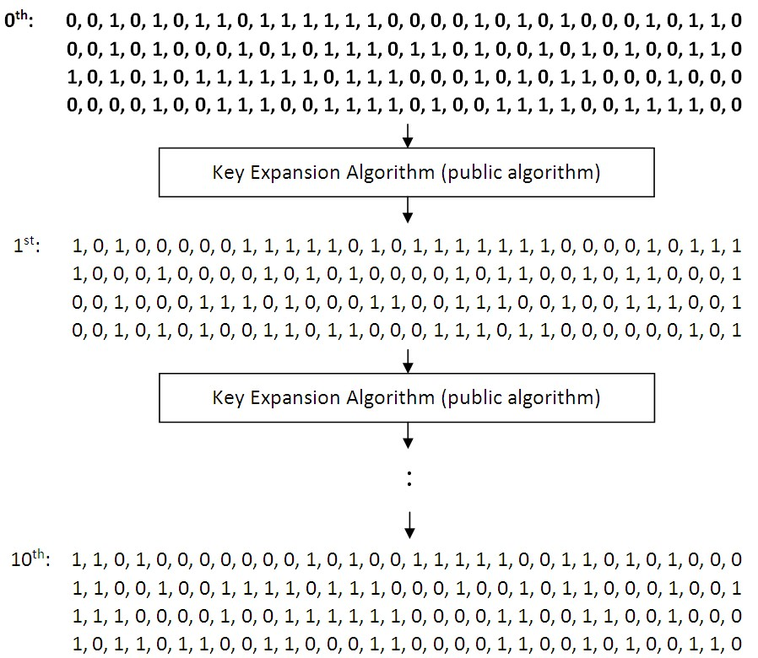
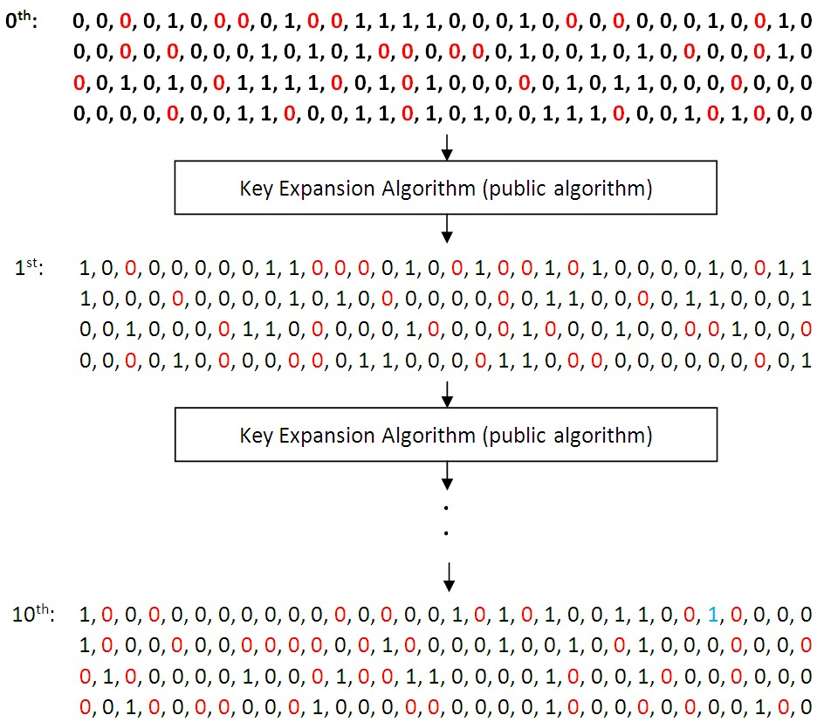
Example of Key Schedule
Original key schedule
Decayed key schedule
reverse flipping error
Goal: correct errors in the decayed key schedule

Slide 9
Key Expansion Algorithm
Given the 128-bit initial key, the following equations characterize bit-relations among the bits in the last 10 round keys:
(r-1)^{th} round
key bit
AES-128 key expansion algorithm
r^{th} round key bit
: i^{th} bit of the r^{th} round key, 1≦r≦10, 0≦i≦127
: i^{th} bit of the 0th round key, copied from the initial key, 0≦i≦127
: i^{th} bit of a round-dependent word, 0≦i≦31, 1≦r≦10
: an S-Box function in algebraic normal form (ANF), 0≦x≦7
input: , output: one bit

Slide 10
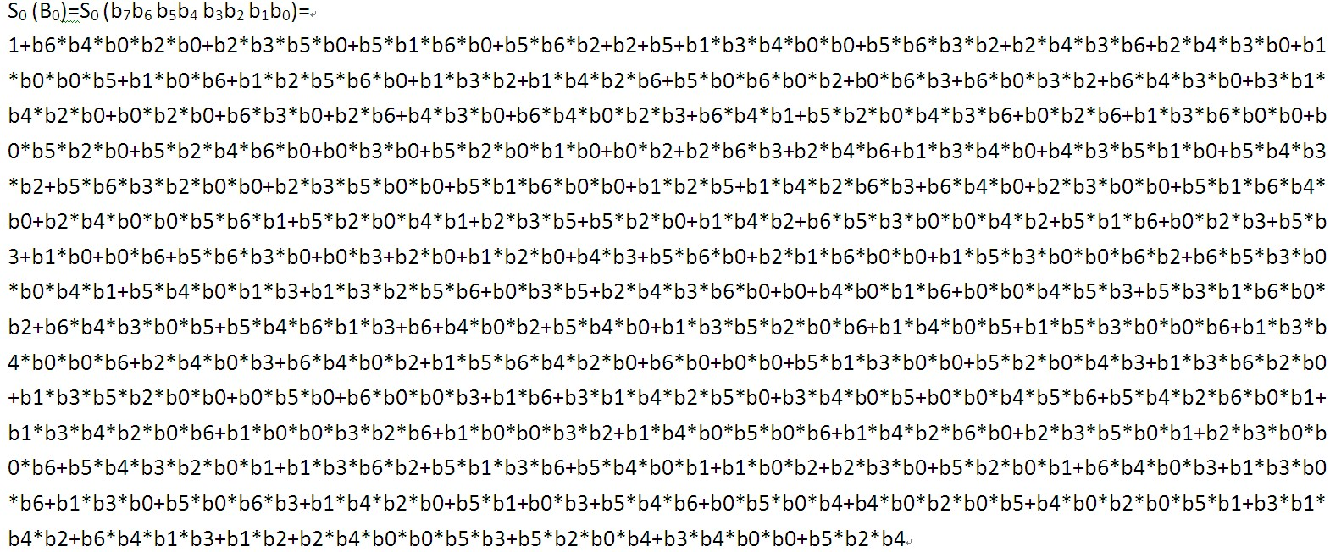
Example of S₀(B₀)
ANF formula:
+: xor operation
*: and operation

Slide 11

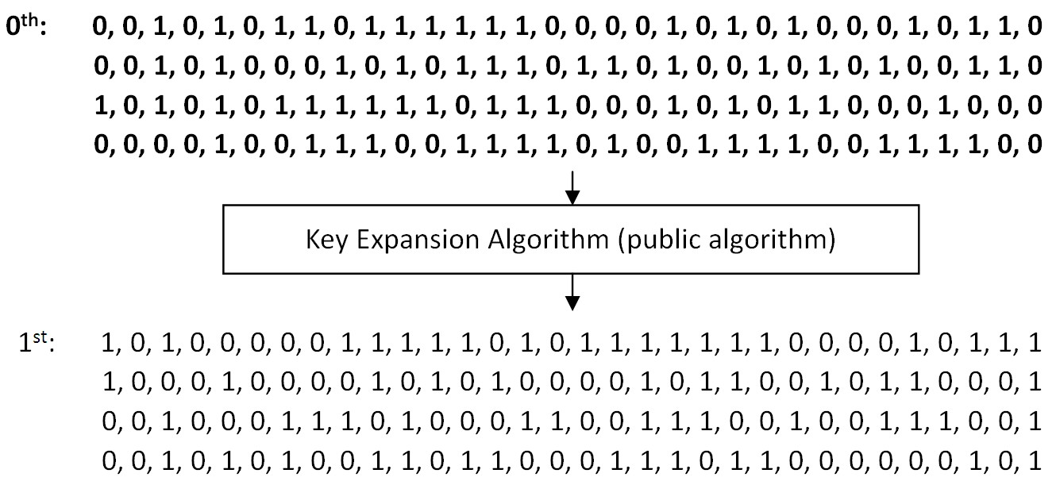

Example of Bit Representation
    Summary: each bit in the latter 10 rounds is computed from its former bits → bit-relations

Slide 12
Outline
Cold Boot Attack
Advanced Encryption Standard (AES)
Recover AES key Schedule
  Using SAT solvers
  Using MaxSAT solvers
  Comparison
Experiment
Conclusion

Slide 13
Assumption of AES Key Recovery
Assumption
  Perfect assumption
    Decay occurs only on 1s
    No reverse flipping errors: no 0s flip to 1
  Realistic assumption
    Decay occurs mainly on 1s
    A few reverse flipping errors: 0.1% of 0s flip to 1
This work
  Recover AES-128 key schedule based on the realistic assumption

Slide 14
Recover AES keys using SAT solvers
    All 1s in the key schedule are treated as hard constraints
    All bit-relations are treated as hard constraints
    CryptoMiniSat: support XOR operation natively
    e.g., understand
No. of formulas: 128*10=1280
.
.
.
    Perfect assumption ¹
    No bit flips from 0 to 1
    All 1s in the key schedule are correct
¹ Kamal et al., Applications of SAT solvers to AES key recovery from decayed key schedule images, 2010.

Slide 15
Recover AES keys using SAT solvers
    All 1s in the key schedule are treated as hard constraints
    All bit-relations are treated as hard constraints
    CryptoMiniSat: support XOR functions natively
    e.g.,
.
.
.
    S_{x}(B_{i}): ANF formula, XORing conjunctions of variables, e.g.,

Slide 16
Recover AES keys using SAT solvers
    All 1s in the key schedule are treated as hard constraints
    All bit-relations are treated as hard constraints
    input
.
.
.
    CryptoMiniSat
    Perfect assumption
    No bit flips from 0 to 1
    All 1s in the key schedule are correct
    output
    SAT + assignment of all bits

Slide 17
Recover AES keys using SAT solvers
    All 1s in the key schedule are treated as hard constraints
    All bit-relations are treated as hard constraints
incorrect
    input
.
.
.
1
    CryptoMiniSat
Flip from 0 to 1
    Realistic assumption
    Some bits flip from 0 to 1
    Not all 1s in the key schedule are correct
    output
    UNSAT

Slide 18
Recover AES keys using SAT solvers
    All 1s in the key schedule are treated as hard constraints
    Hard constraints on bit-relations
0
0
0
0
    CryptoMiniSat
.
.
.
1
Flip from 0 to 1
No
SAT?
    Realistic assumption
    Some bits flip from 0 to 1
    Not all 1s in the key schedule are correct
Yes
    SAT + assignment of all bits

Slide 19
Recover AES keys using SAT solvers
To recover a key schedule with n 1s and k reverse flipping errors
  In the best case:
    CryptoMiniSat needs to run times
  In the worst case
    CryptoMiniSat needs to run times

Slide 20
Recover AES keys using MaxSAT solvers
Deal with two kinds of constraints
  Hard constraints: must be satisfied
  Soft constraints: may be unsatisfied
MaxSAT solver
  Try to satisfy all hard constraints and the maximum number of soft constraints

Slide 21
Recover AES keys using MaxSAT solvers
    All 1s in the key schedule are treated as soft constraints
    All bit-relations are treated as hard constraints
unsatified
What is XOR?
    input
.
.
.
1
    MaxSAT solver
Flip from 0 to 1
    Realistic assumption
    Some bits flip from 0 to 1
    Not all 1s in the key schedule are correct
    output
    Maximum No. of satisfied soft constraints
    + assignment of all bits

Slide 22
Recover AES keys using MaxSAT solvers
Convert XOR to clauses
  Direct conversion:
    n variables → 2^{n-1} clauses
  Cut-up conversion: Cut long formula into shorter ones
(￢B_{i} ∨ ￢B_{j} ∨ ￢B_{k} ) ∧
(￢B_{i} ∨ B_{j} ∨ B_{k} ) ∧
(B_{i} ∨ ￢B_{j} ∨ B_{k} ) ∧
(B_{i} ∨ B_{j} ∨ ￢B_{k} ) ∧
direct conversion

Slide 23

Comparison
Recover AES key schedule in the presence of reverse flipping errors
 | SAT solver | MaxSAT solver
Treat 1s as | Hard constraints | Soft constraints
Need to run a solver multiple times for solving an instance? | Yes | No
Support XOR natively? | Yes | No
51,440 clauses and XOR formulas for representing bit-relations
372,240 clauses for representing bit-relations

Slide 24
Outline
Cold Boot Attack
Advanced Encryption Standard (AES)
Recover AES key Schedule
  Using SAT solvers
  Using MaxSAT solvers
  Comparison
Experiment
Conclusion

Slide 25
Experiment(1/4)
Solver
  SAT: CryptoMiniSat
  MaxSAT: Pwbo2.0
    Better than Akmaxsat, WMaxSatz, QMaxSAT, QMaxSAT-g2, WPM1, PM2
Environment
  Core i5-2540 @ 2.6GHz / 8GB

Slide 26
Experiment (2/4)
Setting (real situation)
  Decay factor (probability of 1→0): 30%-76%
  Probability of flipping 0 to 1: 0.1%
  Number of instances for each decay factor: 100
Result
  MaxSAT is superior to SAT approach
Decay factor (%) | CryptoMiniSat (s) | Pwbo2.0 (s)
30 | 45.8 | 0.943
40 | 28.467 | 0.956
50 | 19.665 | 1.168
60 | 26.524 | 1.560
70 | 225.379 | 12.532
72 | 678.452 | 26.782
74 | 1004.161 | 231.610
76 | 1116.353 | 296.415
  Among100 instances, the average of No. of instances with 0, 1, 2 reverse flipping errors is 50, 36, 14, respectively

Slide 27
Experiment (3/4)
Setting
  Decay factor (probability of 1→0): 30%-76%
  Number of reverse flipping errors (0 →1): 1
  Number of instances for each decay factor: 100
Result
  The superiority of MaxSAT is not obvious when the number of reverse flipping errors is 1
Decay factor (%) | CryptoMiniSat (s) | Pwbo2.0 (s)
30 | 2.045 | 1.037
40 | 1.310 | 1.088
50 | 1.971 | 1.345
60 | 5.026 | 2.252
70 | 43.532 | 14.945
72 | 47.603 | 28.354
74 | 280.825 | 161.740
76 | 480.101 | 384.348

Slide 28
Experiment (4/4)
Setting
  Decay factor (probability of 1→0): 30%-74%
  Number of reverse flipping errors (0 →1): 2
  Number of instances for each decay factor: 40
Result
  MaxSAT is far superior to SAT when the number of reverse flipping errors is 2
Decay factor (%) | CryptoMiniSat (s) | Pwbo2.0 (s)
30 | 198.638 | 1.464
40 | 162.249 | 1.562
50 | 224.689 | 2.184
60 | 329.621 | 4.676
70 | 3047.821 | 47.725
72 | 4909.565 | 245.177
74 | 14715.607 | 2160.648

Slide 29
Outline
Cold Boot Attack
Advanced Encryption Standard (AES)
Recover AES key Schedule
  Using SAT solvers
  Using MaxSAT solvers
  Comparison
Experiment
Conclusion

Slide 30
Conclusion
Recover AES key schedule in the presence of reverse flipping errors
  SAT solver:
    Treat all 1s as hard constraints
    Run the solver repeatedly until it outputs SAT
    CryptoMiniSat: support XOR natively
  MaxSAT solver:
    Treat all 1s as soft constraints
    Solver needs to run only one time
    Do no support XOR natively
    Superior to the SAT approach

Slide 31
The end
Thanks for your attention

